Slide 1


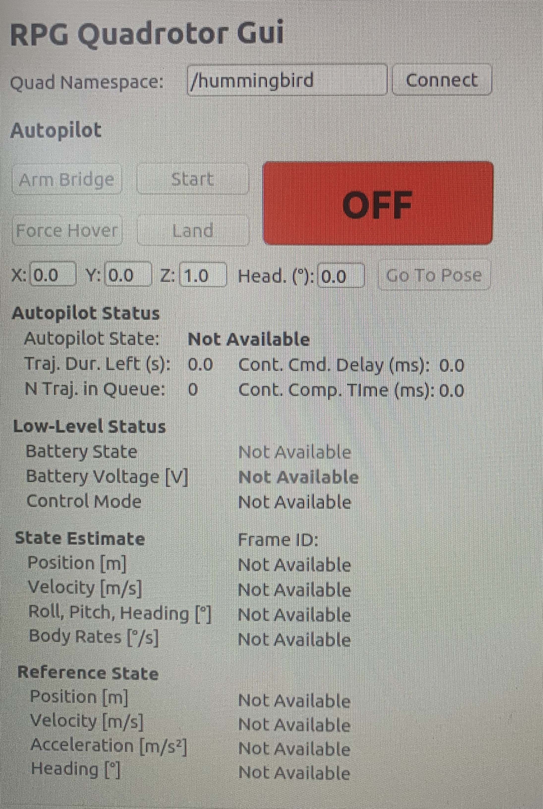
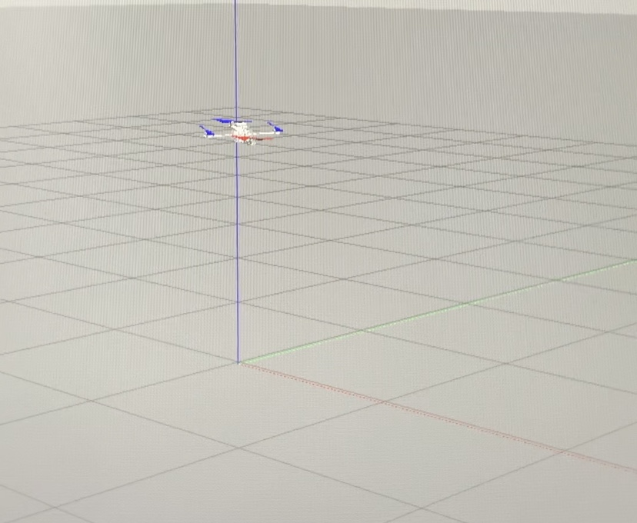
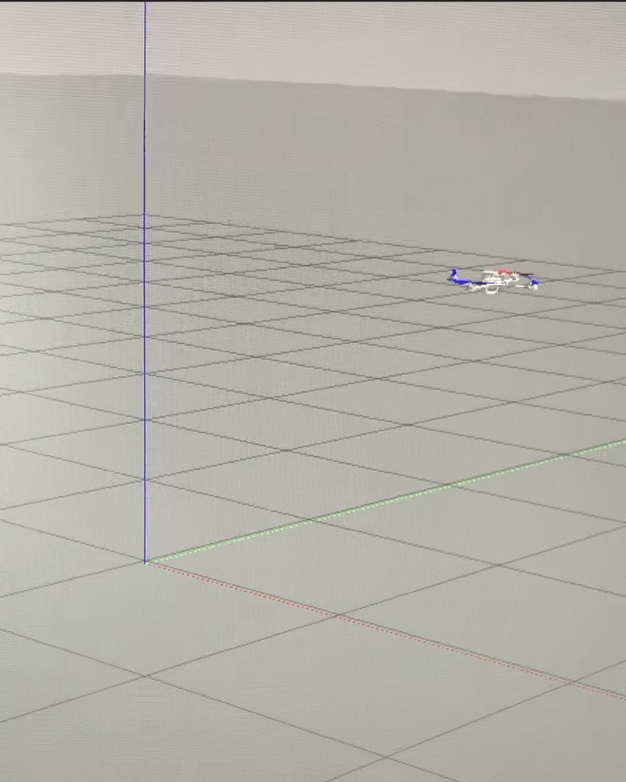
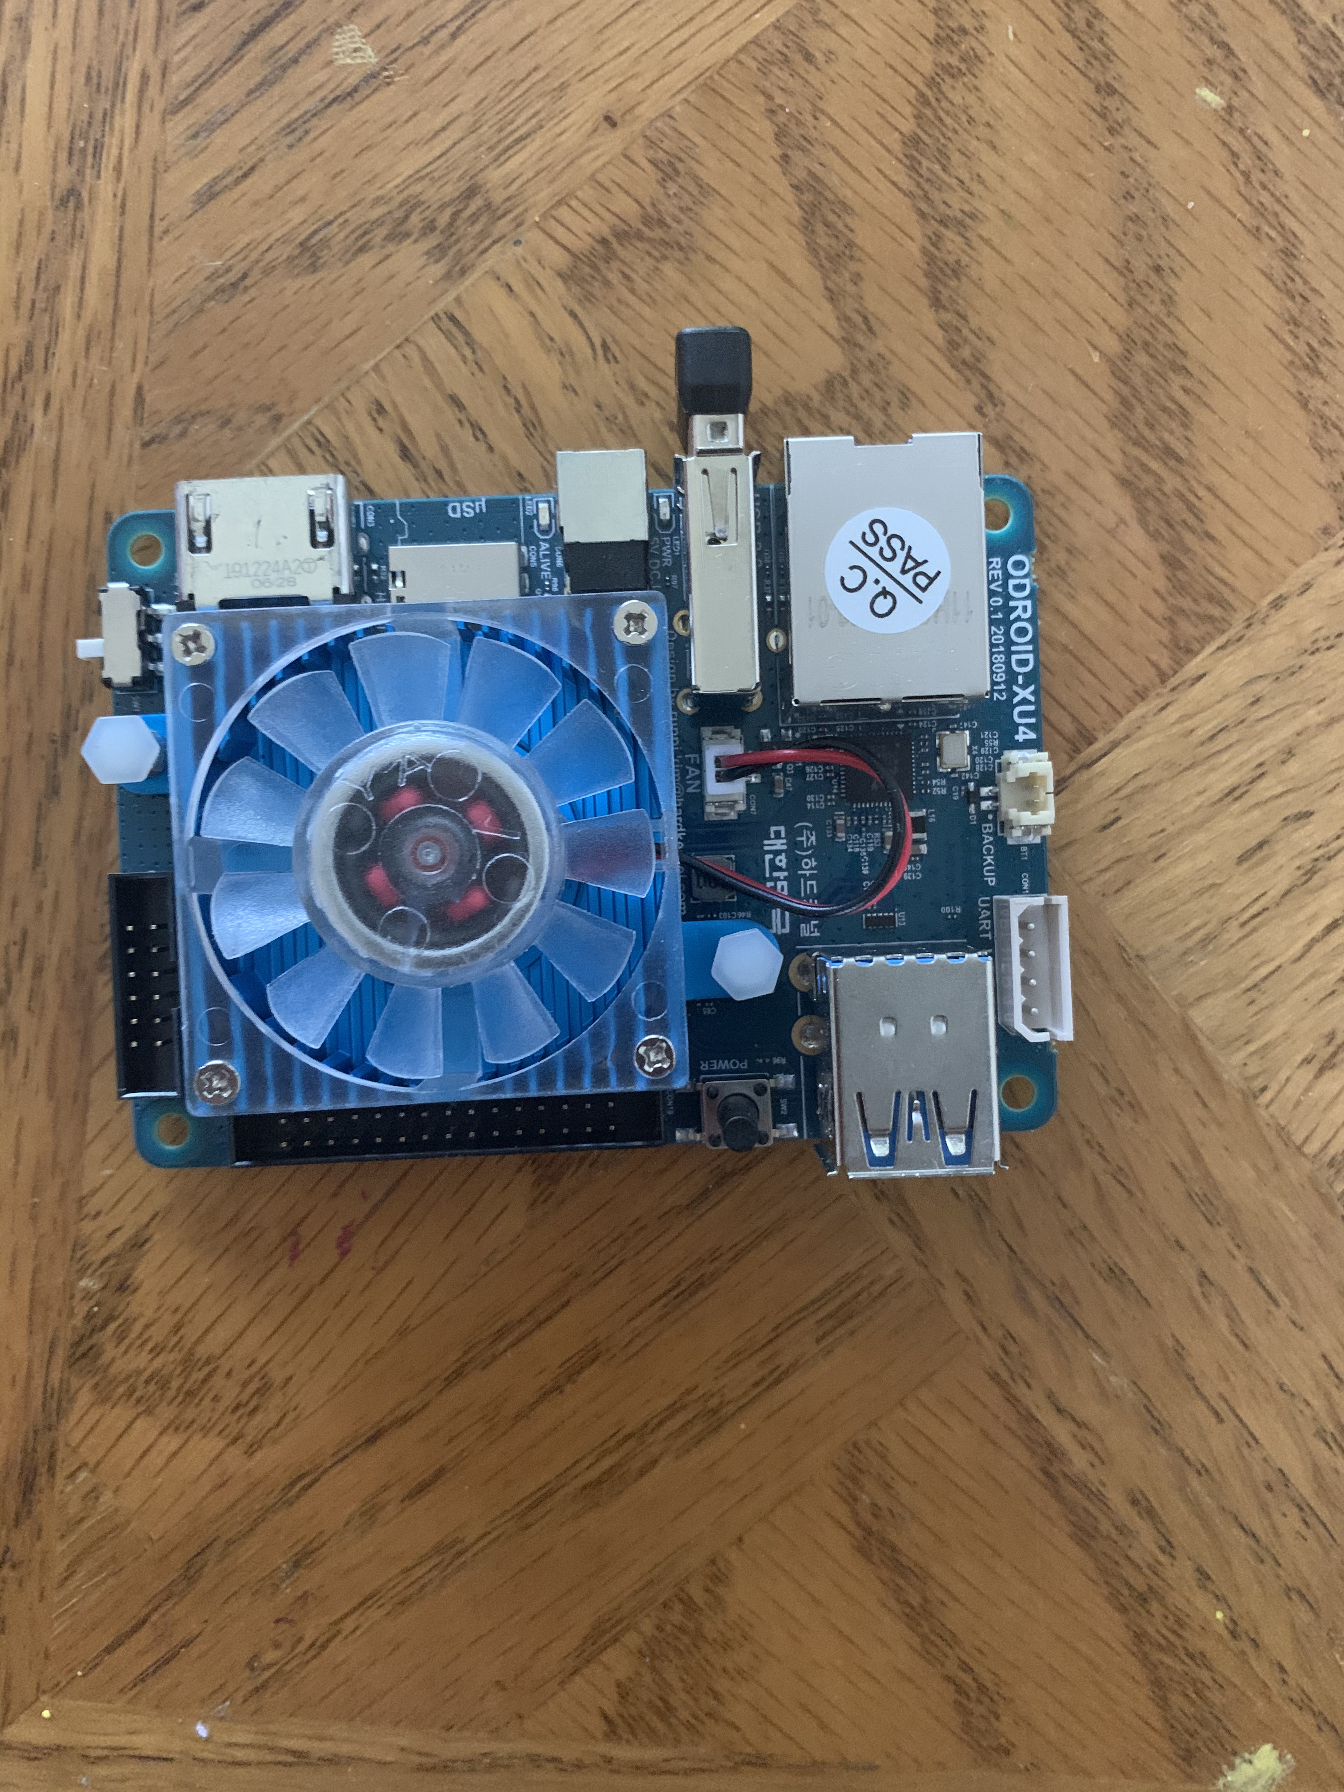
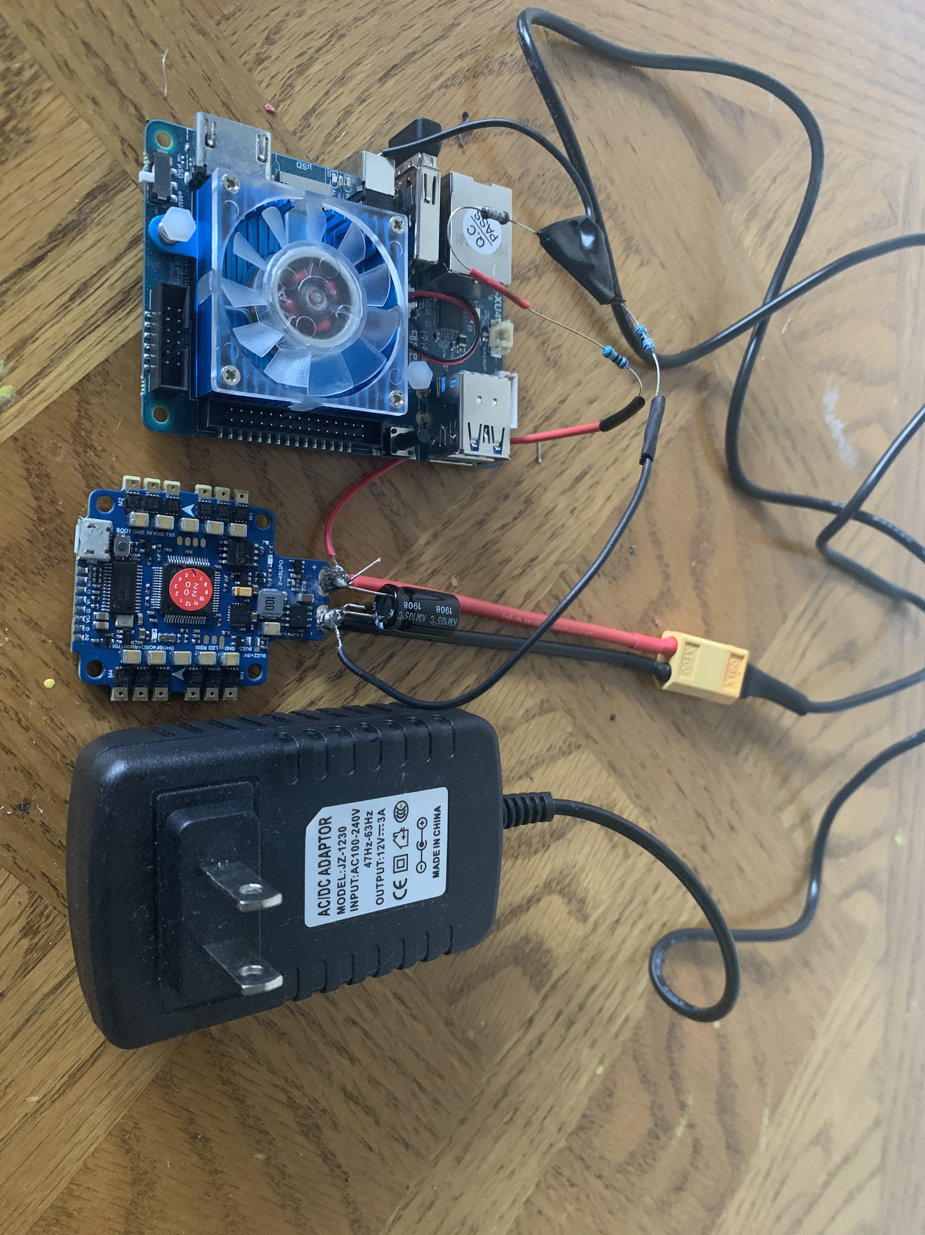
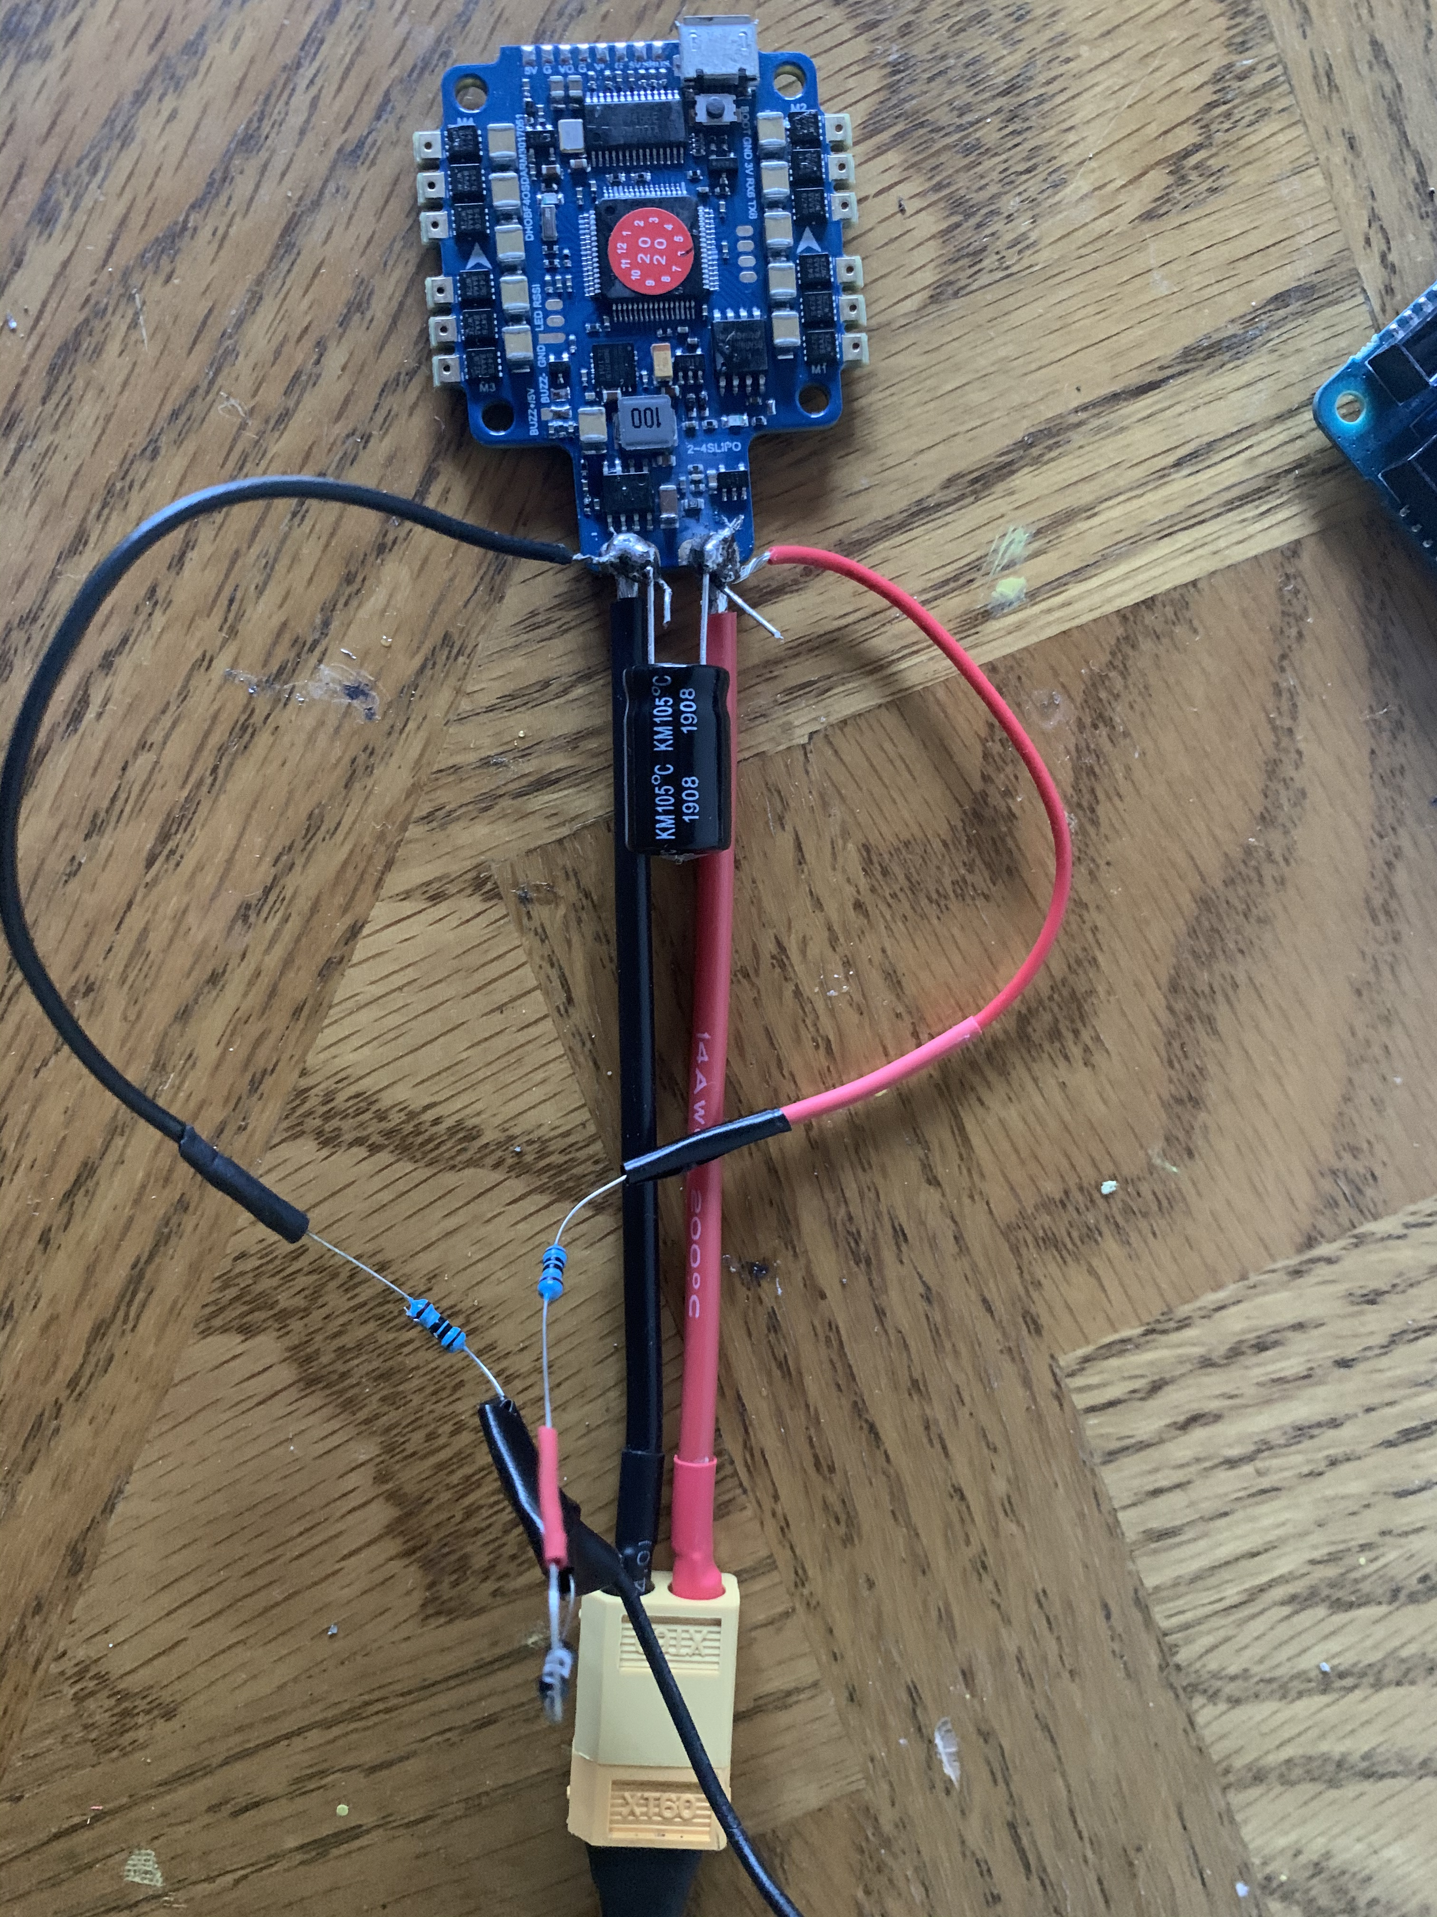
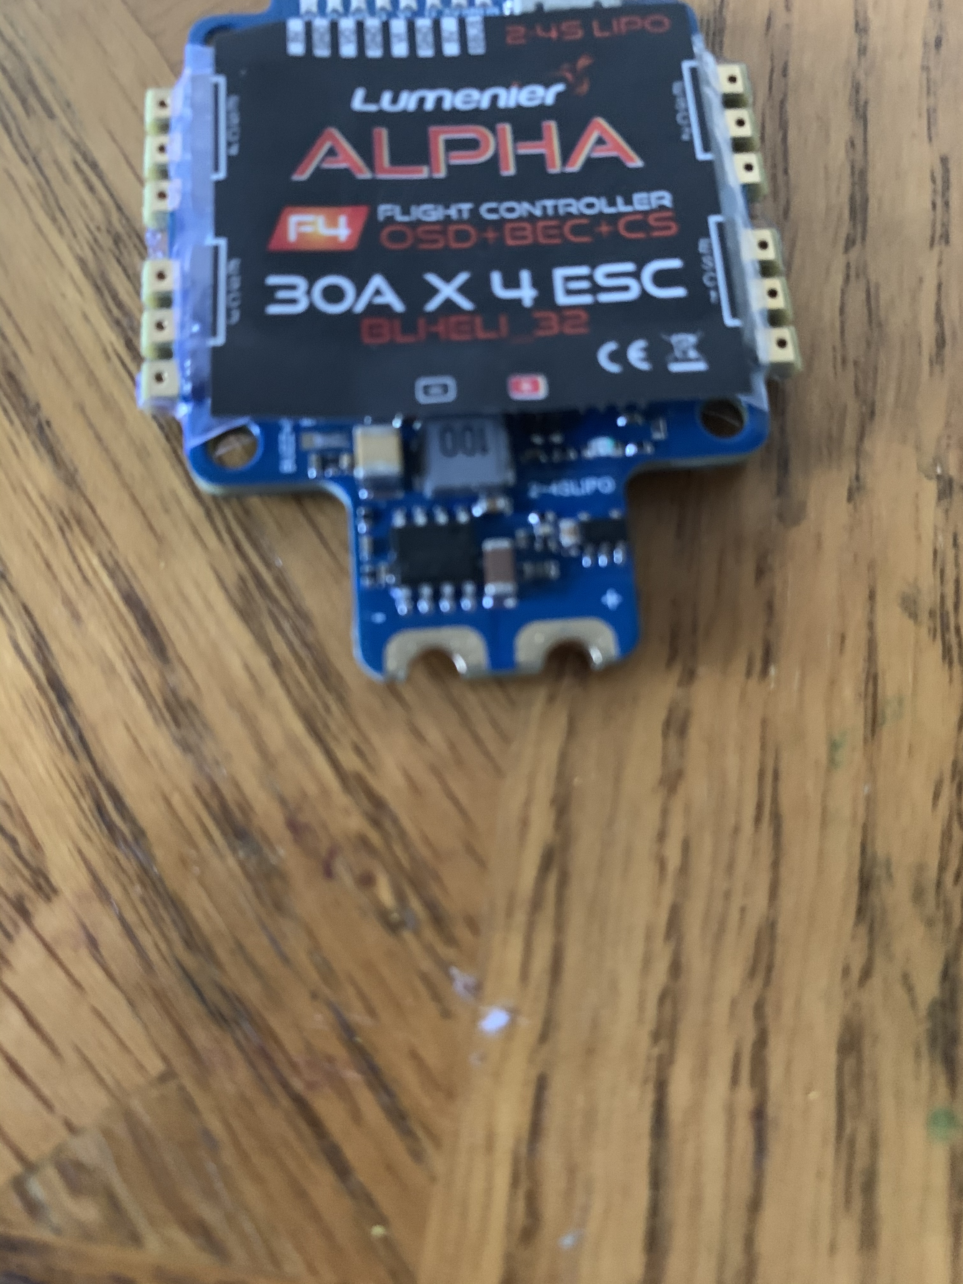
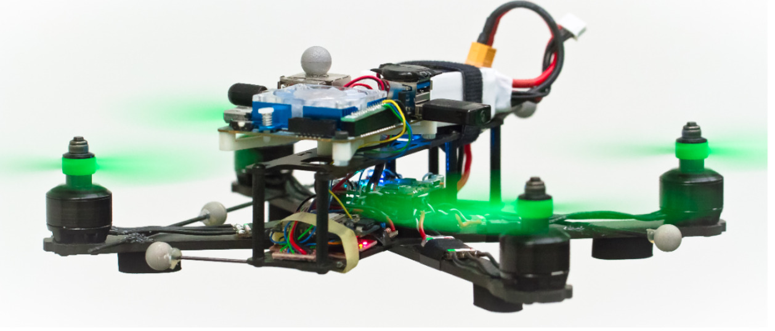
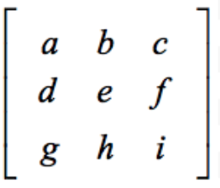
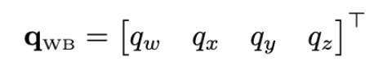
The Advanced Control of Autonomous Quadrotors
Rohan Narayan, Dr. Laurent Burlion
The Department of Mechanical and Aerospace Engineering, Rutgers University, Piscataway, New Jersey 08854
Abstract
Materials and Methods
Results
Various algorithms and stability techniques are being implemented through drone research to further the field in controlling drones. Expanding this field of research is paramount in automating drones and improving their efficiency for military and commercial uses. The University of Zurich’s Robotics and Perception Group has been researching quadrotors and have proposed a set of algorithms that improve the control of drones. The goal of this study is to see if an autonomous quadrotor can be programmed to fly through a course faster than a manned drone, using the framework and set of algorithms presented by the University of Zurich. The RotorS Gazebo plugins which are designed to simulate a quadrotor’s environment, will be used to remotely test the algorithms. Additionally, the Robotics and Perception Group’s suggested quadrotor hardware assembly will be used to build a drone and test the algorithms in a controlled environment in the future in order to test the hypothesis that an autonomous quadrotor can fly through a course faster than a manned drone. Before the drone can be fully built, the various components of the drone will be tested remotely away from the lab to set up the construction of the drone. The results of this research will further the field of drone stability and enhance algorithms to make autonomous drones more efficient than manned drones. Ultimately, this can be used for military, surveillance, and even delivery uses as drones are being implemented to improve all of those areas.
To test autonomous capabilities of a drone, the drone has to first be built
The University of Zurich’s Robotics and Perception Group designed a high-speed quadrotor accompanied by a set of algorithms to control it, published in a GitHub repository and described in several research papers
To run tests on the drone, I started building the quadrotor outlined in the published papers and GitHub wiki
The Quadrotor Hardware:
Fig. 2. Odroid Xu4/Flight Controller Fig. 3. Wiring Guide [1]
I started programming the hardware above and assembling the parts – not in a lab
To test the algorithms, ROS (Robotics Operating System) can be used in conjunction with Gazebo, a simulation environment, to simulate the quadrotor [1]
The algorithms designed by the Robotics and Perception Group use quaternions to describe the quadrotors orientation
3D orientation is often described by a 3x3 rotation matrix or set of Euler angles [2]
Fig. 5. Quaternion
Fig. 4. Rot. Matrix
Quaternions better describe 3D orientation for programming purposes as Euler angles are susceptible to losing degrees of freedom and rotation matrices require more numeric precision [2]
Quaternions allow for easier interpolation between orientations [2]
Using conversions between quaternions, rotation matrices, and Euler angles, the algorithms can perform complex tasks like trajectory generation
Implemented the algorithms in MATLAB to better understand them myself
Tested algorithms with ROS and Gazebo simulations using Linux commands
Fig. 6. Simulation Frame 1 Fig. 7. Simulation Frame 2. Fig. 8. User Interface
The simulations show that the algorithms are effective in a controlled simulation environment
Fig. 9. Hardware Components Fig. 10. Wiring/Soldering
The hardware is being connected effectively, with certain flight controller parameters being set up
Due to an inability of going into a lab, certain components like the motor and LiPo battery cannot be used and the drone cannot be fully built at home yet
Background
Drones are a technology being implemented with many uses, including delivery, surveillance, and military uses
A class of drones called the quadrotor is a type of Unmanned Aerial Vehicle (UAV) with two pairs of propellers rotating in opposite directions [1]
Fig. 1. Quadrotor [1]
There exists plenty of research in this field, including quadrotor assemblies and algorithms to control them, so this research hopes to expand on and supplement existing publications
This research can then be used as a platform for future research and to improve quadrotor maneuverability and control
Conclusion
Until the drone can be fully constructed in a lab setting, no conclusions can be drawn as of yet, but given the progress already made, the results can be expected to further our understanding of control algorithms for, quadrotors and establish a framework for future research to be made as well.
Future Direction
Once I go into the lab, I will fully assemble the drone, including a proper carbon frame, motors, propellers, and such. Then, we can conduct tests on the drone’s capabilities in a lab setting to further develop the algorithms and improve the quadrotor.
References
Acknowledgments
[1] M. Faessler, A. Franchi, and D. Scaramuzza, "Differential Flatness of Quadrotor Dynamics Subject to Rotor Drag for Accurate Tracking of High-Speed Trajectories," IEEE Robot. Autom. Lett. (RA-L), vol. 3, no. 2, pp. 620–626, Apr. 2018.
[2] M. Faessler, D. Falanga, and D. Scaramuzza, "Thrust Mixing, Saturation, and Body-Rate Control for Accurate Aggressive Quadrotor Flight," IEEE Robot. Autom. Lett. (RA-L), vol. 2, no. 2, pp. 476–482, Apr. 2017.
I would like to express my deepest gratitude to Dr. Laurent Burlion, who provided me with the resources and support to guide me in this project, as well as the Aresty Research Center for providing support and funding.

